Slide 1
Assignment 2
Due: Tuesday 05/07, Points: 30

Slide 2
You’ve learned in Chapter 8 and 9.
Inheritance
Abstract Class
Overriding
Constructor
Polymorphism
Encapsulation
Be Confident of You!
You are ready to develop world’s most famous App.

Slide 3
RECALL
Secretary
getHours()
getSalary()
getVacationDays()
getVacationForm()
takeDictation(String text)
Marketer
getHours()
getSalary()
getVacationDays()
getVacationForm()
Lawyer
getHours()
getSalary()
getVacationDays()
getVacationForm()
class Employee
getHours() getSalary() getVacationDays() getVacationForm()
class Secretary
takeDictation(String text)
class Marketer
class Lawyer
Sue
Jessica
..
Ed
Tom
..

Slide 4
public class Employee {
public int getSalary() {
return 40000;
}
. . .
public String getVacationForm() {
return "yellow";
}
}
public class Lawyer extends Employee {
public int getSalary() {
return super.getSalary+10000;
}
public String getVacationForm() {
return “pink";
}
}
Employee ed = new Lawyer();
System.out.println(ed.getSalary());
System.out.println(ed.getVacationForm());
Employee Tom = new Lawyer();
System.out.println(Tom.getSalary());
System.out.println(Tom.getVacationForm());
Employee Sue = new Secretary ();
System.out.println(Sue.getSalary());
System.out.println(Sue.getVacationForm());

Slide 5

You are the CEO of Burger211 Company

Slide 6
About Burger211 Company
Burger211 manages 1000+ shops in different countries.
Burger211 sells 3 burgers: inheritance Burger, overriding Burger, polymorphism Burger.
All 3 burgers have a name, Kcal value, price in US$ and toppings. These values were decided by the HQ in advance.
Each country displays their own style of menu because of different language, price, currency and culture.
All the Buger211 shops in the same country have to display the same format of menu at their shops.
Menu contains the shop name, all 3 burger names, their Kcal values, their prices, and their toppings.
The prices should be displayed in their own currency. (eg: price of an inheritance burger is $1.5, your country’s exchange rate is 500 and use €, price of the burger is € 750)
If the country hosts a special event, all the Burger211 shops in the country participate to the promotion event.
eg) During the Winter Olympic in Korea, price of all the burgers are 50% off at all the Burger211 shops in Korea.
If people in the country never eat chicken meat, you have to remove chicken from the toppings. In such case, Kcal value should be changed as well.

Slide 7
public class burger211 { public static void main(String[] args) { String franchiseName;
String Burger1Name = “inheritance Burger";
String Burger2Name = “overriding Burger";
String Burger3Name = “polymorphism Burger";
String Burger1Topping = “beef patty, tomato, onion, ranch source";
String Burger2Topping = “beef patty, lime, onion, lettuce, tomato source";
String Burger3Topping = “chicken breast, gallo, onion, ranch source";
int Burger1Kcal = 210; int Burger2Kcal = 211; int Burger3Kcal = 140;
Double Burger1Price=1.75; Double Burger2Price=2.0; Double Burger3Price=2.5;
franchiseName = “Bellevue”;
System.out.println(franchiseName);
System.out.println(Burger1Name + “ : “ + Burger1Price + “ “ + Burger1Kcal );
System.out.println(Burger1Layer);
System.out.println(Burger2Name + “ : “ + Burger2Price + “ “ + Burger2Kcal );
System.out.println(Burger2Layer);
System.out.println(Burger3Name + “ : “ + Burger3Price + “ “ + Burger3Kcal );
System.out.println(Burger3Layer);
franchiseName = “Seattle”;
System.out.println(franchiseName);
System.out.println(Burger1Name + “ : “ + Burger1Price * rate * promotion+ “ “ + Burger1Kcal );
System.out.println(Burger1Layer);
System.out.println(Burger2Name + “ : “ + Burger2Price * rate * promotion+ “ “ + Burger2Kcal );
System.out.println(Burger1Layer);
System.out.println(Burger3Name + “ : “ + Burger3Price * rate * promotion+ “ “ + Burger3Kcal );
System.out.println(Burger1Layer); } }
1,000+ Franchises!!

Slide 8

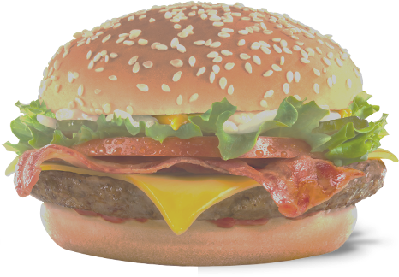

FIRE!

Slide 9
Burger211
burgerName() burgerPrice() burgerCal() menu()
USA
@override menu(){ }
Canada
@override menu(){ }
Korea
@override menu(){ }
Bellevue Seattle
Renton
…
Vancouver
Ottawa
.
Seoul
Incheon
.

Slide 10
MMBellevue, USA
MMInheritance Burger: 371Kcal $1.75 MM[beef patty, tomato, onion, ranch source]
MMOverriding Burger: 303Kcal $2.0 MM[beef patty, lime, onion, lettuce, tomato source]
MMPolymorphism Burger: 505Kcal $3.5 MM[chicken breast, gallo, onion, ranch source]
Desired Output (Text Version)
MPyeongChang, KOREA MMM MMM^^ Winter Olympic Special Promotion 50% OFF ^^ MMM MMMInheritance Burger / W875.0 (Was:1750.0) / 371Kcal MMM[beef patty, tomato, onion, ranch source] MMM MMMOverriding Burger / W1000.0 (Was:2000.0) / 303Kcal MMM[beef patty, lime, onion, lettuce, tomato source] MMM MMMPolymorphism Burger / W1750.0 (Was:3500.0) / 505Kcal MMM[gallo, onion, ranch source]

Slide 11
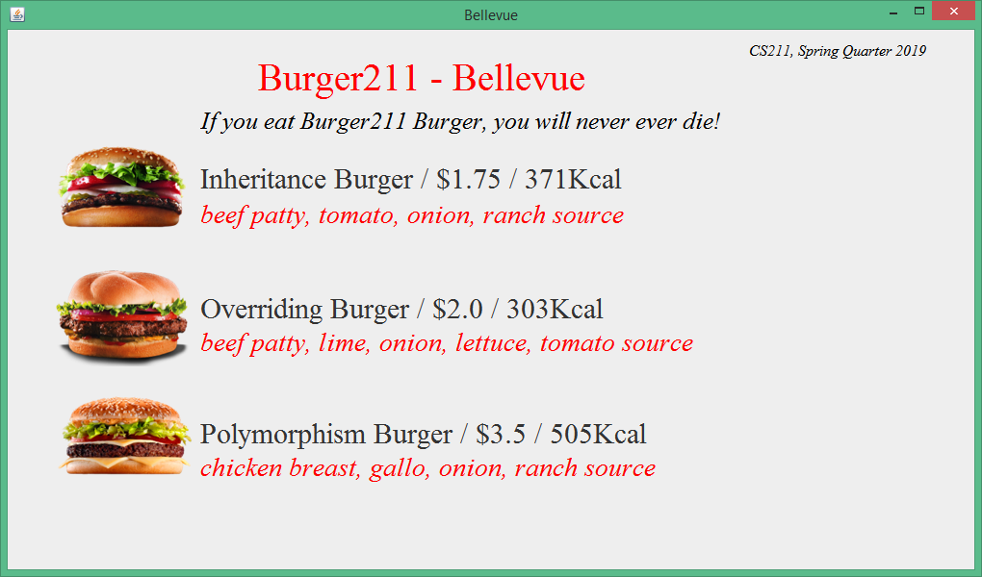
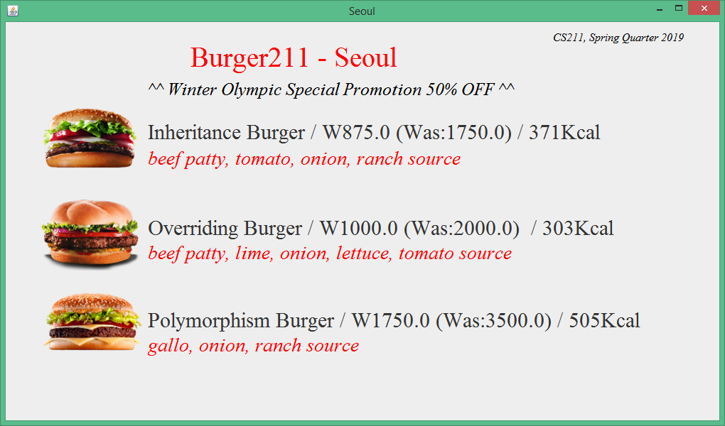
Desired Output (GUI Version)

Slide 13
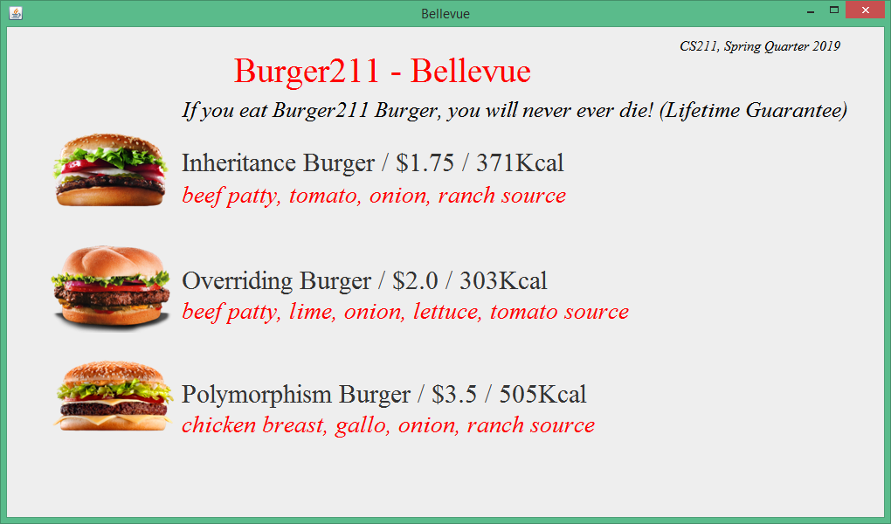

Slide 14
This is a Group Project.
Burger211.java
anyCountry.java
USA.java
Menu.java
(GUI)
myBurger211.java
(Main)
Taesik kim
You

Slide 15
Example of Super Class
public abstract class Burger211{ static/public/private/protected/(default) double b1Price, b2Price, b3Price; static/public/private/protected/(default) String b1Name, b2Name, b3Name; static/public/private/protected/(default) String b1Topping, b2Topping, b3Topping; static/public/private/protected/(default) int b1Cal, b2Cal, b3Cal; static/public/private/protected/(default) String pro; static/public/private/protected/(default)) double proRate; Burger211() { setBurgerName(); setTopping(); setCal(); setPrice(); } public abstract void printMenu(String franchise); public static void setBurgerName(){ b1Name="Inheritance Burger"; . . }
public void setTopping(){ b1Topping="beef patty, tomato, onion, ranch source"; . . }
.
.

Slide 16
Example of Sub Class
class KOREA extends Burger211 {
KOREA(){
. . .
}
@Override
public void printMenu(String franchise ){
// text version
System.out.println(b1Name + b1Price + . . . );
. .
// GUI version
String b1Info=b1Name + ": " +b1Cal + "Kcal" + " KW"+b1Price;
. . .
new MenuGUI(franchise,b1Info,b1Topping,b2Info,b2Topping,b3Info,
b3Topping,promo);

Slide 17
How to call GUI menu
new MenuGUI(franchise, b1Info, b1Topping, b2Info,b2Topping,b3Info,b3Topping,promo);

Slide 18
Example of Main
public class myBuger211 { public static void main(String[] args) { Burger211 Seoul = new KOREA();
. . } }

Slide 19
Requirements. (must include)
2 countries (USA + one more country) and 2 franchises to each country.
inheritance concepts
constructor concept.
at least one run-time Polymorphism concept.
at least one compile-time Polymorphism concept.
at least one Encapsulation
promotion for each franchise.
print menu for each franchise. (text version and GUI version)

Slide 20
References
(based on the previous quarter assignment)

Slide 21
How to use other class
Two ways
Code (.java) | Include .java in your project (or package) use the .java class_name A = new class_name();
 | Create a new package import classes in the new package import taesikGUI.MenuGUI;
.jar file (java archive)
.jar file (java archive)

Slide 22

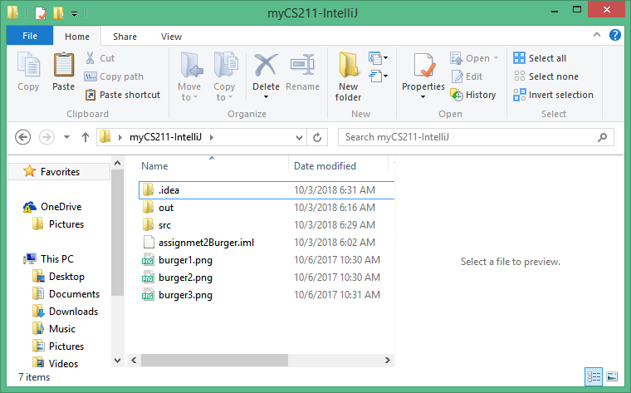
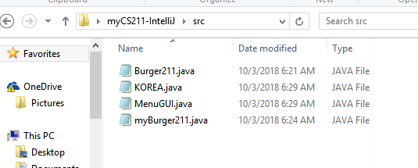

Slide 23
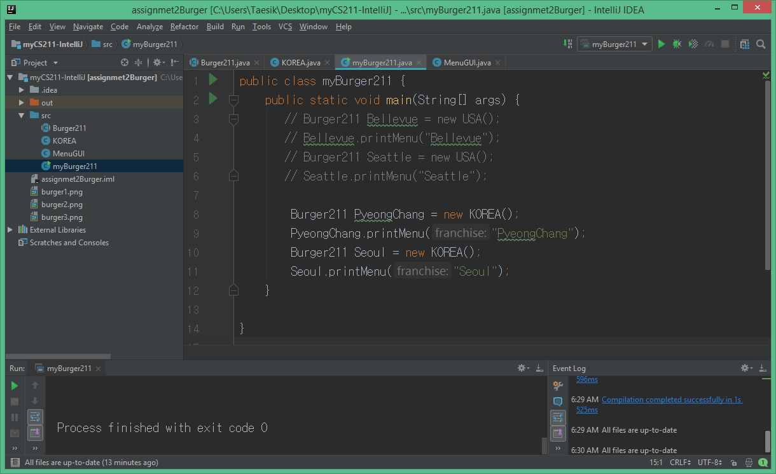

Slide 24
@Override public void printMenu(String franchise){ // text version String b1Info=b1Name + " / " + "W" +b1PriceDiscount +" (Was:" + b1Price+") / "+ b1Cal + "Kcal"; String b2Info=b2Name + " / " + "W" +b2PriceDiscount +" (Was:" +b2Price+") / "+ b2Cal + "Kcal"; String b3Info=b3Name + " / " + "W" +b3PriceDiscount +" (Was:" + b3Price+") / "+ b3Cal + "Kcal"; System.out.println(franchise + ", KOREA"); System.out.println(); System.out.println(ad); System.out.println(); System.out.println(b1Info); System.out.println("["+b1Topping+"]"); System.out.println(); System.out.println(b2Info); System.out.println("["+b2Topping+"]"); System.out.println(); System.out.println(b3Info); System.out.println("["+b3Topping+"]"); System.out.println(); // GUI version new MenuGUI(franchise,b1Info,b1Topping,b2Info,b2Topping,b3Info,b3Topping,ad); }
@Override public void printMenu(String franchise){ // text version System.out.println(franchise + ", KOREA"); // GUI version new MenuGUI(franchise,b1Info,b1Topping,b2Info,b2Topping,b3Info,b3Topping,ad); }

Slide 25

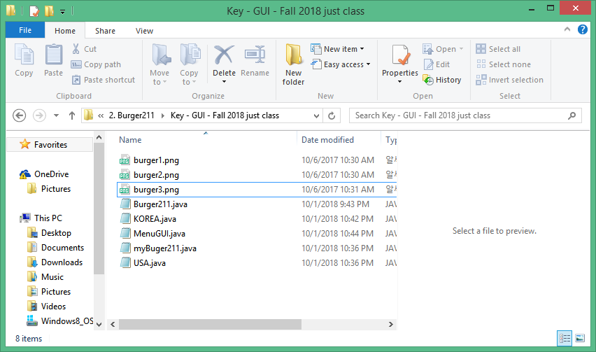
Download all the files in the same folder as the project you write.

Slide 26
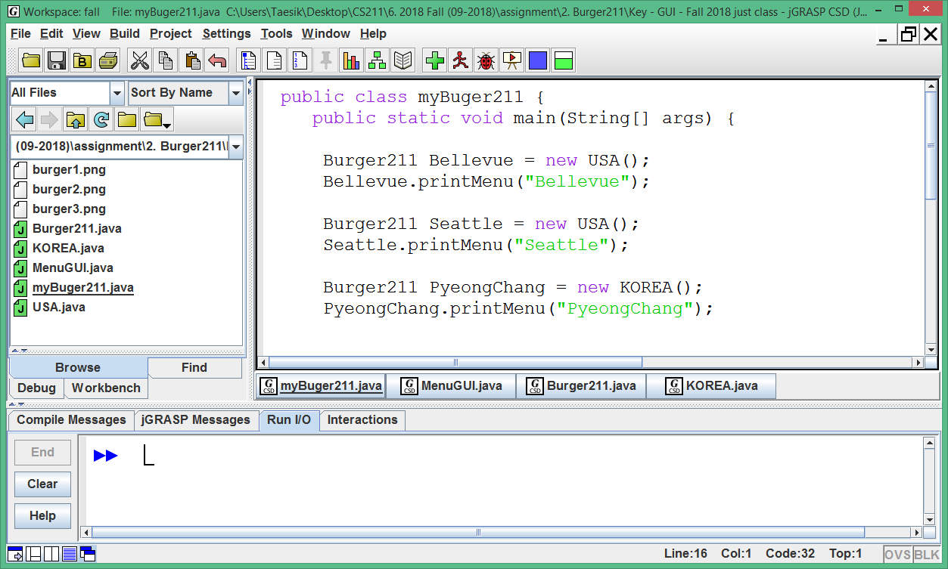

Slide 27

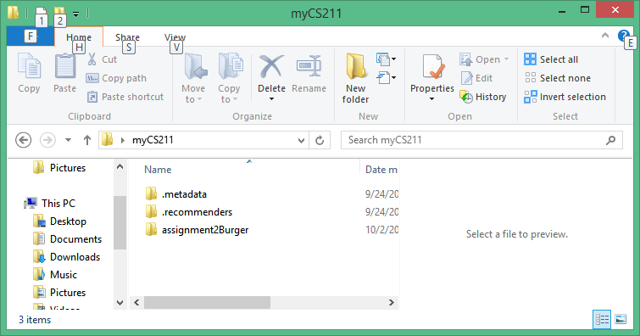
workspace
project

Slide 28
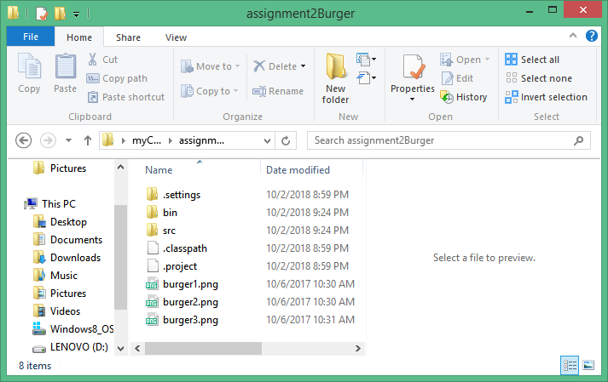
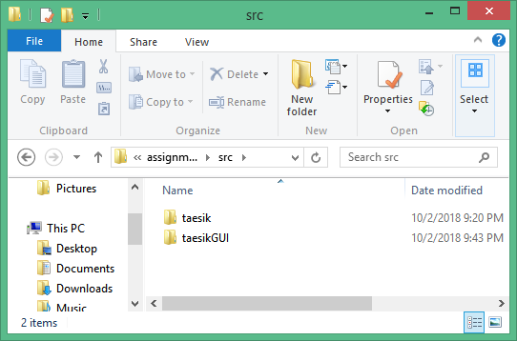
package and .java files
image files
Two Packages

Slide 29

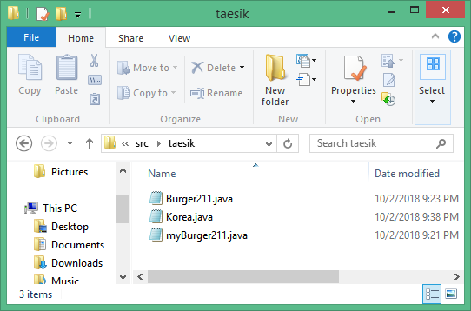
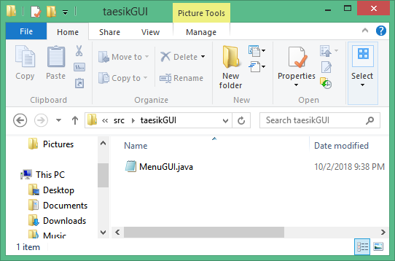

Slide 30
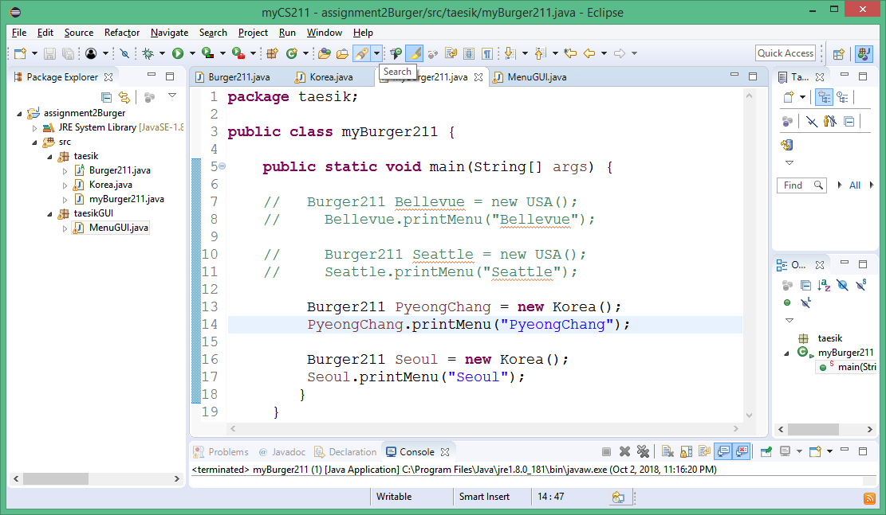
Two Packages in assignment2Burger project

Slide 31
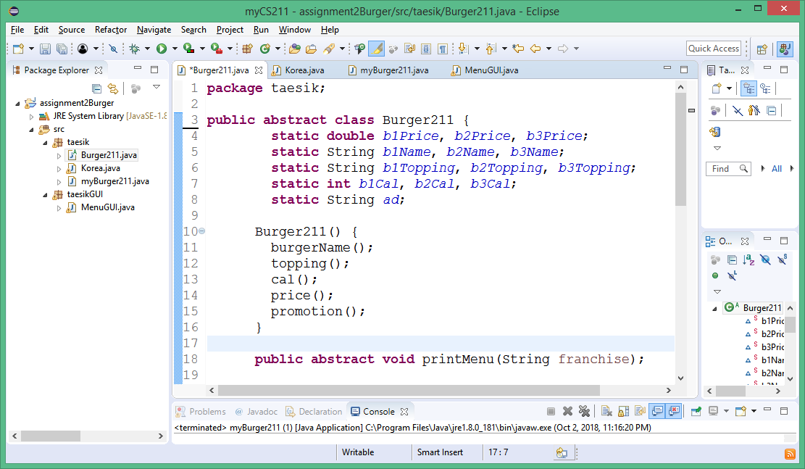
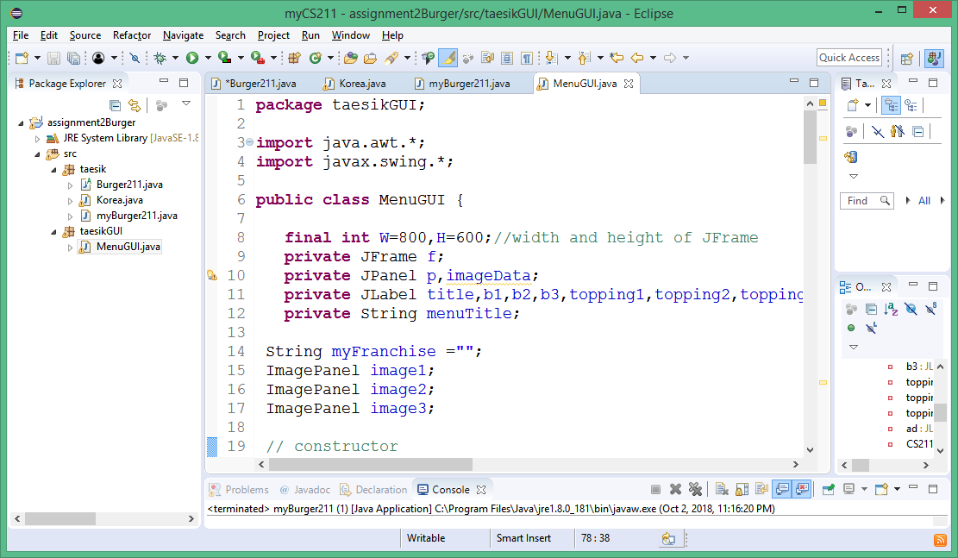

Slide 32
package taesik;
import taesikGUI.MenuGUI;
public class Korea extends Burger211{
Korea() {
}
public void printMenu(String franchise){
// text version
. .
// GUI version
new MenuGUI(franchise,b1Info,b1Topping,b2Info,b2Topping,b3Info,b3Topping,ad);
}
}

